Slide 6
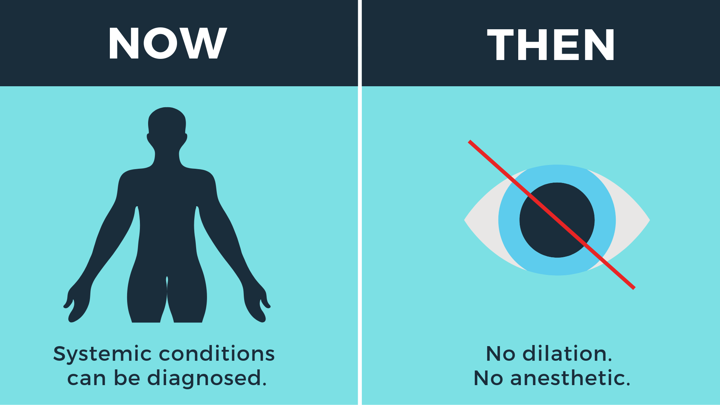

Slide 8
Notes:
In fact, ALL medical diagnosis and treatment you provide is because of COA’s efforts

Slide 9
…against opticians & medical assistants performing refractions
…against corporations dictating how you practice
…against costly patient notification mandates
…protecting patient safety & public health

Slide 13
HIGHER MEDICARE REIMBURSEMENTS
TOOLS TO PROVIDE BEST POSSIBLE PATIENT CARE
AOA EVIDENCE-BASED
CLINICAL PRACTICE GUIDELINES
Adult Eye and Vision Examination
Pediatric Eye and Vision Examination
Notes:
Clinical Practice Guidelines: What are they?
Public Documents – education for patients
Professional Liaison Documents
Part of OD Curriculum
Supporting Documents for Scope and Expansion
Support Optometrists on the front lines.
To address the problem of multiple guidelines with varying information, possible bias and questionable trustworthiness .
U.S. Congress through the Medicare Improvements for Patients and Providers Act of 2008, asked the Institute of Medicine (IOM) to determine the best methods for guideline development
Reports were released in March 2011 (final 2012 - AOA Follows These Standards for Guidelines.

Slide 14
EDUCATION & LEARNING
$499 Members
$650 Non-Members
20 hours CE + meals
+ expo + reception
$75 Members
$199 Non-Members
6 hours CE +
breakfast & lunch
12 articles annually
included with
membership
That’s 12 hours CE!
Discounted
registration rate
for members!

Slide 15
INCREASED MEDICARE REIMBURSEMENTS
Included with COA-AOA membership (non-members pay $1,800 a year), AOA MORE is a registry that pairs with your EHR system to capture data and provide feedback to all registry users on patient outcomes for specific treatments, which spurs cost-effective improvements and innovation in health care delivery, and can lead to reimbursement bonuses of up to 27 percent.
The health care system is changing. Public and private health plans are transitioning from traditional fee-for-service payment to consumer-directed health plans and value-based reimbursement systems, such as pay-for-reporting, pay-for-performance, bundling and Accountable Care Organizations (ACO).
Register today at www.AOA.org/MORE

Slide 17
COA-SPONSORED INSURANCE
COAMEMBERINSURANCE.COM

Slide 19
MEDICAL RECORDS & CODING HELP
Medical Records & Coding Service is designed to educate doctors and staff on medical recordkeeping and documentation, compliance and coding. The guidance received by the coding experts will support doctors and staff in providing the best possible patient care while ensuring accurate reimbursements are received.
Resources and support provided to members include advisory and educational information related to:
Accurate choices of procedure and diagnosis codes for eye care
Understanding and preparing for payer audits of patient care and coding
Changes in Medicare and coding policies
ICD-10 preparation and conversion

Slide 21
ENDORSED BUSINESS PARTNERS GIVE YOU:
AOA ENDORSED BUSINESS PARTNERS GIVE YOU:
Optometry’s Career Center
Student Loan Consolidation
HIPAA Compliance
Health IT Solutions
Credit Card Processing
Practice Financing
Group Purchasing Discounts
Practice Transitions
Williams Group hotline for members : (866) 595-1471
Retirement Planning
Free 15-minute consultation for members: (800) 523-1125
WWW.AOA.ORG/AOAEXCEL

Slide 22
STAY IN “THE KNOW”

Slide 23
INCREASING PUBLIC AWARENESS
Think About Your Eyes is the vision industry's national public awareness campaign promoting
the importance of an annual eye exam with an optometrist.
Notes:
The national eye and vision health education campaign brought to you by The American Optometry Association (AOA),

Slide 24
Have a shorter eye exam cycle – from 29 months to 16 months
Spent more on eyeglasses - $20 per pair on average
828,463 incremental exams driving by seeing or hearing Think About Your Eyes advertising
People who acted after seeing or hearing an ad
Purchased
29% more eyeglasses
Purchased
21% more
contact lenses
All COA members who are practicing ODs receive a complimentary listing on thinkaboutyoureyes.com

Slide 26
QUESTIONS ABOUT MEMBERSHIP
OR YOUR BENEFITS??
Contact Jodi Haas at COA

